Slide 1

Genesis1
Strictly Private & Confidential
No Pricks, Just Scans
A Development By EDGE Agentic Labs
https://genesis1v1.com
DSA CASE COMPETITION

Slide 2
Case Competition Briefing
Goal
Build a proprietary algorithm that estimates haemoglobin reading (“HgB”) from lip images and metadata with ≤ 0.8 g/dL MAE while remaining robust across devices, lighting and skin tones.
Problem & Success Criteria
Input: Front-facing smartphone lip images (+ optional device/lighting metadata)
Output: Predicted HgB (g/dL), one value per image
Primary metric (Leaderboard): MAE on a hidden test set
Win threshold (goal): MAE ≤ 0.8 g/dL (current baseline ≈ 1.8 g/dL)
Tiebreakers: (1) RMSE, (2) mean bias (|avg error|), (3) throughput (images/sec on reference GPU/CPU), (4) model size

Slide 3
Case Competition Briefing
What You Will Receive:
A total of 30 data sets comprising
Train: N_train lip crops + labels (Hgb), stratified by device, lighting class, Fitzpatrick I–VI proxy, gender/age bands
Metadata (only when applicable, available): device model, focal length eq., exposure category, white balance, ISO bucket, capture distance band, ambient light class (bright/indoor/warm/cool), timestamp band.
File Naming Convention & Schema:
image_id.jpg
meta.csv: image_id, device_id, device_brand, device_model, iso_bucket, exposure_bucket, wb_bucket, ambient_light, distance_band, skin_tone_proxy, age_band, gender
labels.csv: image_id, hgb
Note: No faces—only mouth/lip region crops. All PHI removed. Participants are not to attempt re-identification.

Slide 4
Case Competition Briefing
Competition Rules
Originality: All code/models must be your own or properly licensed (MIT/Apache-2.0/BSD), no training on private patient data you don’t have rights to.
External data: Allowed only if openly licensed and declared in your report; must be shareable for audit.
Ensembling: Allowed; disclose components.
EDGE Agentic Labs’ Intellectual Property
Confidentiality: Private sets remain confidential; models may be audited for leakage.
Medical Safety: The algorithm is not a diagnostic device. Outputs are for research. No clinical claims.

Slide 5
Case Competition Briefing
Tracks
Accuracy: Maximise accuracy with ≤ 50 MB model
Edge-Lite Track: ≤ 10 MB model, no GPU at inference, ≤ 100 ms/image CPU
Generalisation Bonus: Extra points for minimal performance drop on Test B (OOD)
Submission Bundle (.zip/.tar)
/code (training + inference scripts; deterministic seeds)
/weights (final model; ONNX or TorchScript + version)
/requirements.txt or environment.yml
inference.py → predict(images_dir, meta_csv) -> predictions.csv
model_card.md (see template below)
report.pdf (≤ 8 pages): approach, data usage, augmentation, model, loss, calibration, error analysis, fairness, ablations, compute cost, failure modes, and next steps
Reproducibility: One-command run: python inference.py --images <path> --meta meta.csv --out preds.csv.

Slide 6
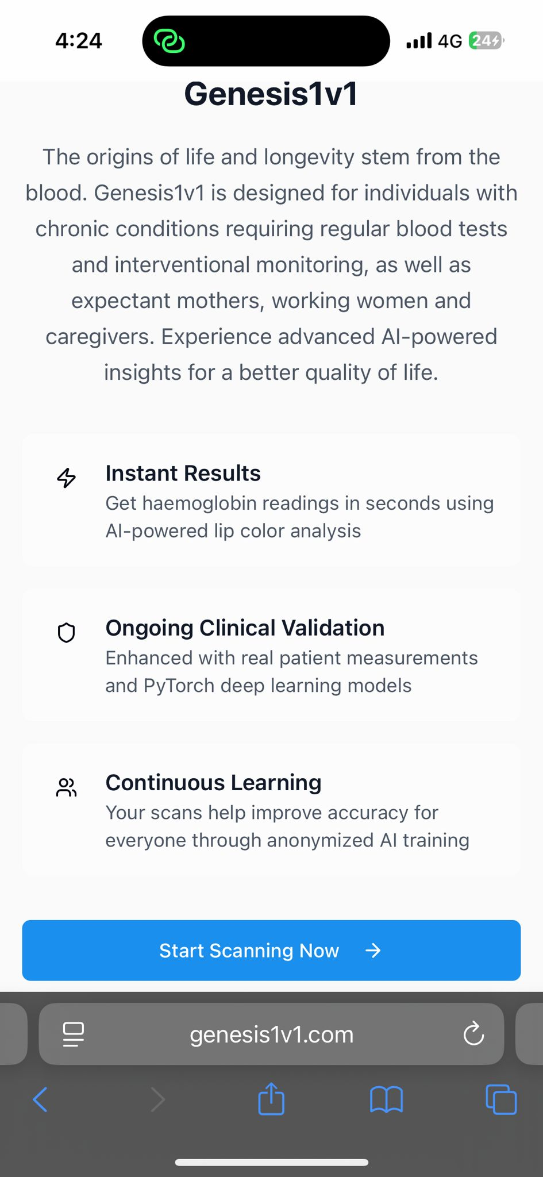
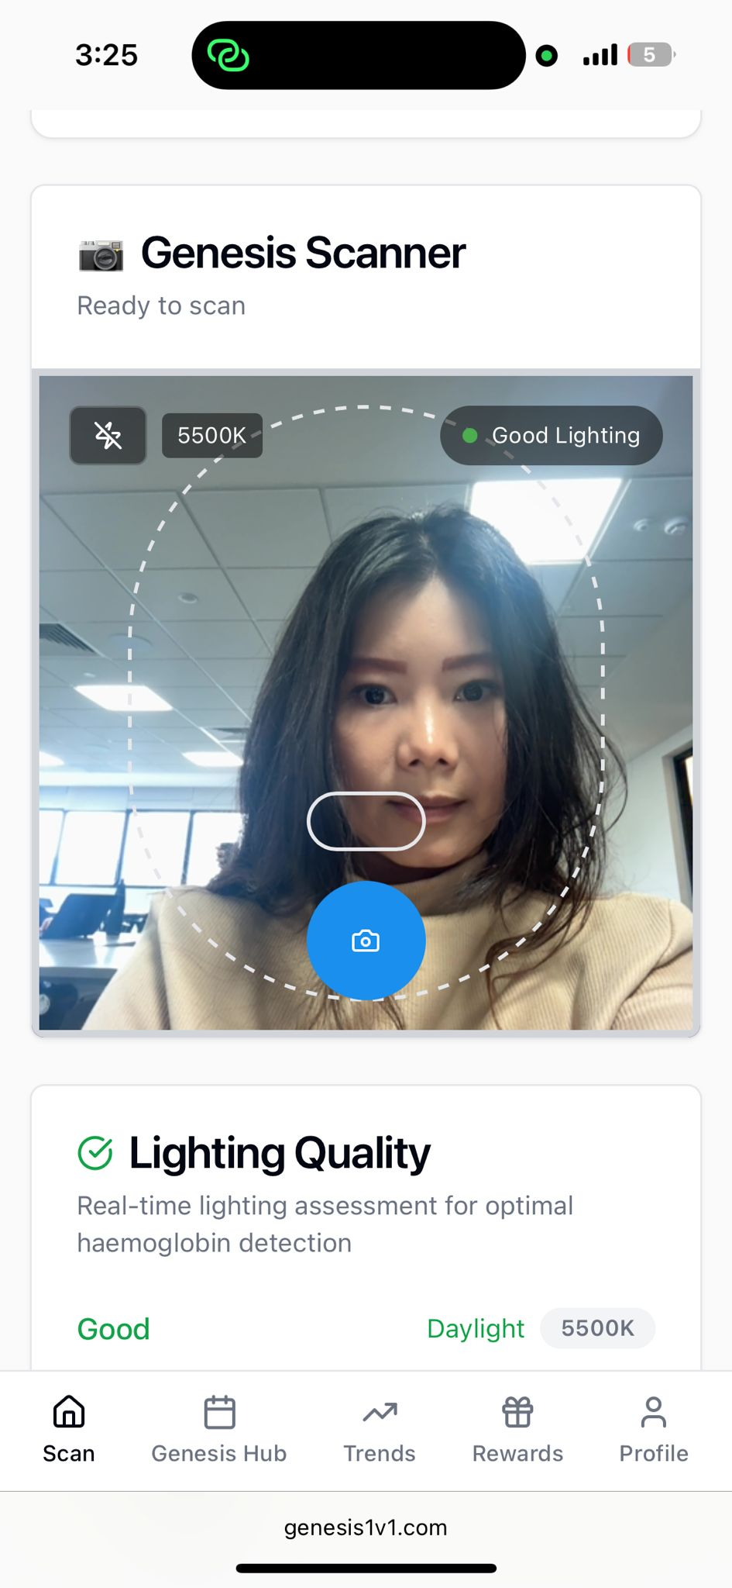
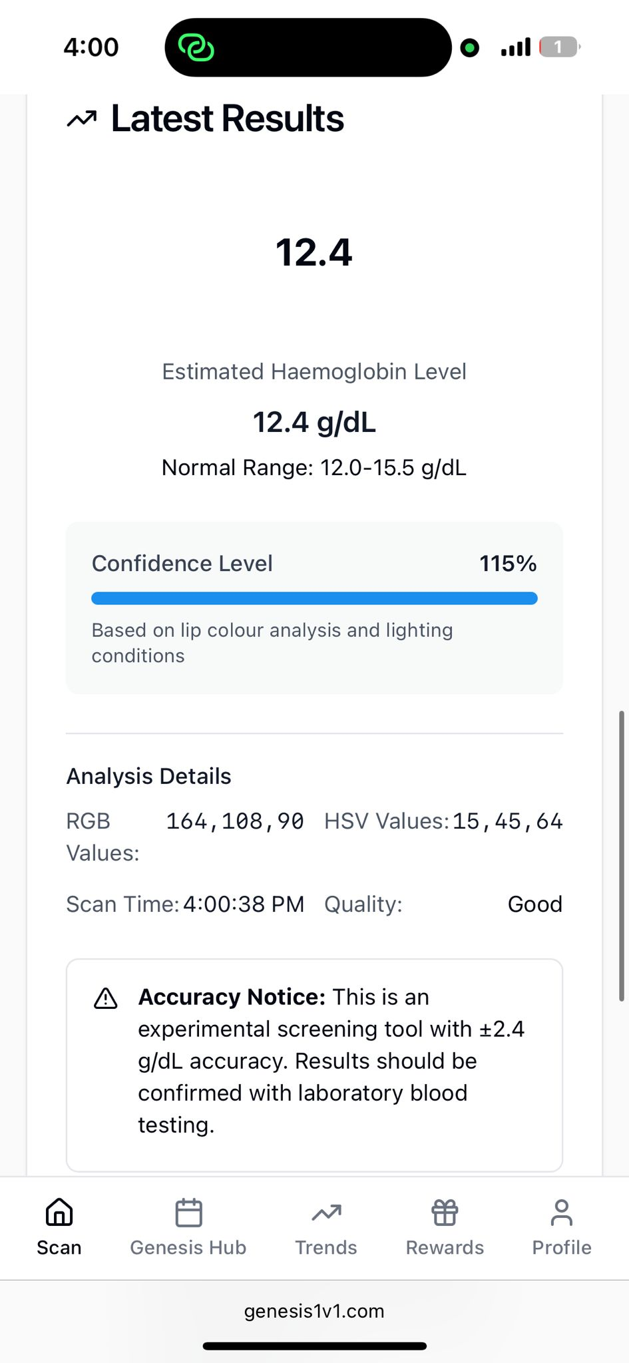
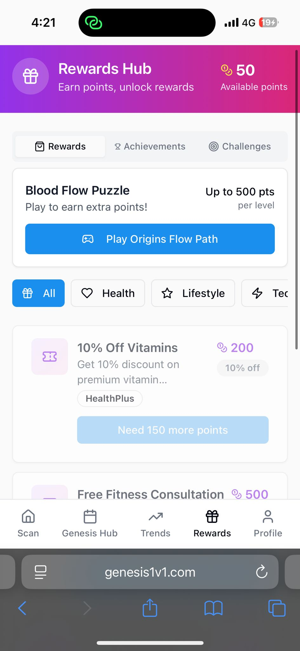
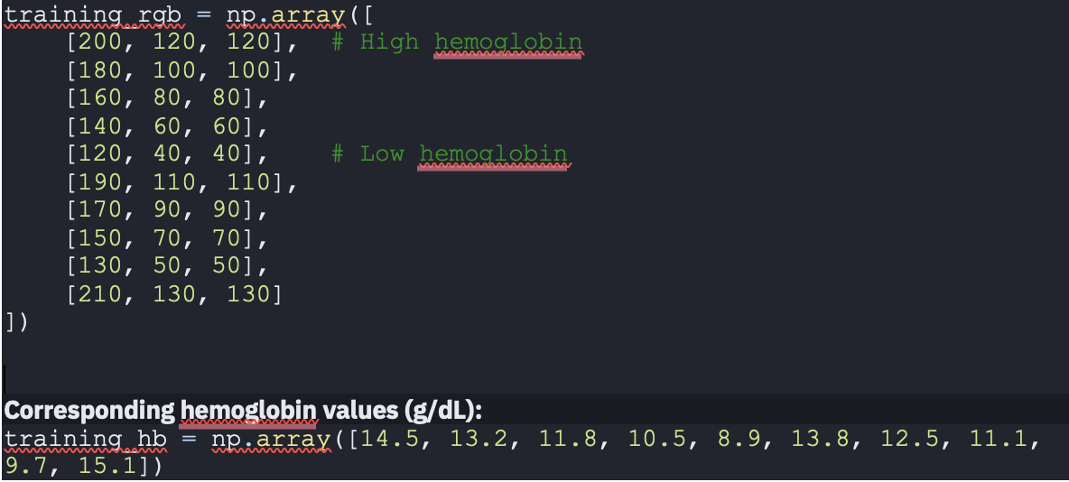
Moving Towards An MVP Phase
Strictly Private & Confidential
The functional version of Genesis 1’s PWA predictions is consistent with clinical findings. The solution is available for end-user testing and commenting. A commercial version will only be made available upon approval by HSA.
User Journey
Step 1
Step 2
Step 3
Step 4
(+/- 1.2 g/dl) accurate since my last donation in April!
To move Genesis1 into commercialisation, massive data is required to train the algorithm to achieve a 97 – 98, 99% accuracy rate.
75%
Prediction accuracy
(Aug ‘25)
95%
Prediction accuracy
(Nov ‘25)
Notes:
How good are you to serve the underserved

Slide 7
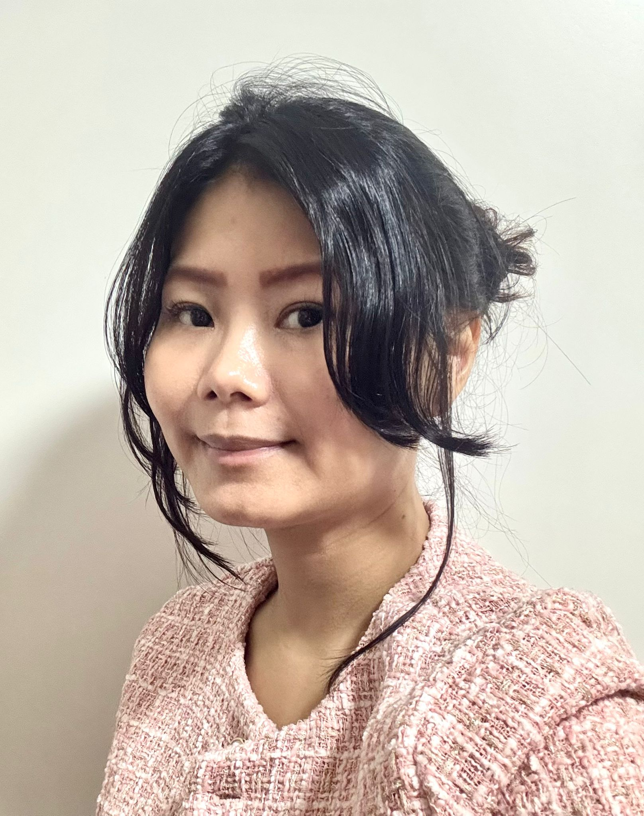
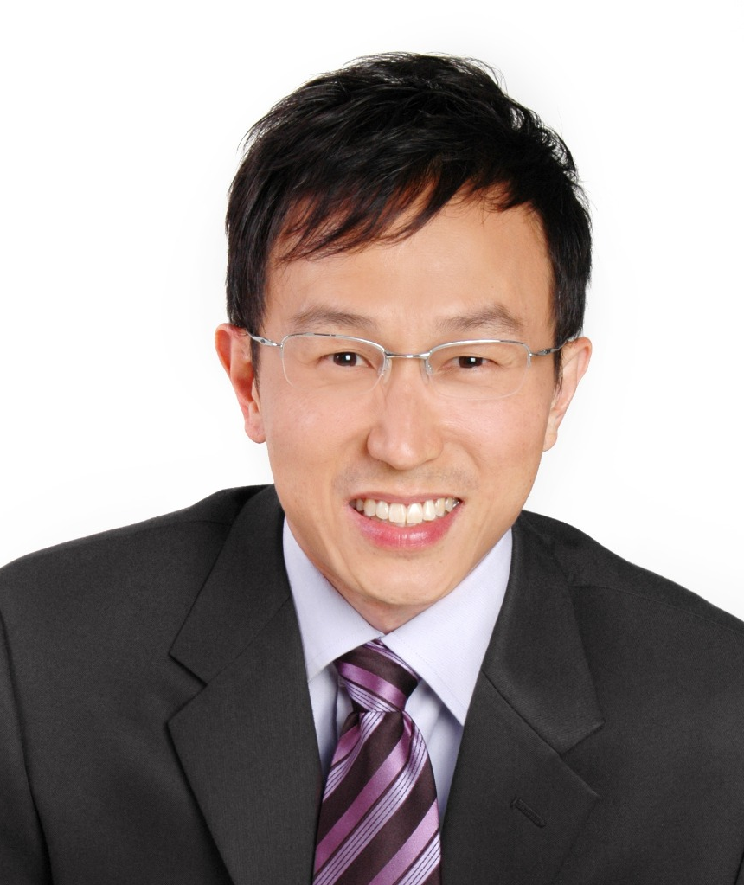
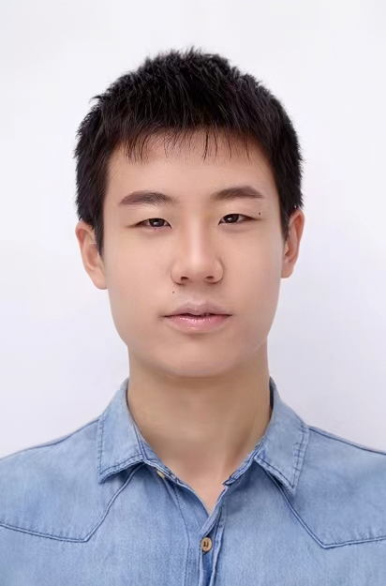
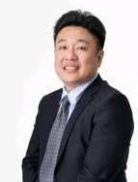
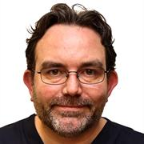
EDGE Agentic Labs: Our Team
Strictly Private & Confidential
We are a team of driven, crazy-minded, hands-on people who will get things done.
Cathy Joyce Tan
The Inventor
exCIMB Bank,
AVP, Investor Relations
EMBA, SMU
Python Coder
Wanted to read an MBBS
NJC, Phy-Chem-Bio A
Fx Blood Donor
Kenneth Cheng
The Rainmaker
Sales Director, Nuralogix
Basf, Evonik
Air Liquide, Murata
Chemistry & Materials Science
Minor in Computing Chemistry, NUS
Wanted to read an MBA
Fx Blood Donor
Dr Matthew Cove
The Doctor
Senior Consultant, Division of Respiratory & Critical Care Medicine, Department of Medicine,
National University Hospital
Dong Zhonghao
The Engineer
exBank of Communications, China
Application Developer
Msc. Computer Science, NTU
Computer Science,
Sun Yat Sun University
Wanted to go to MIT
Gary Ang Yee
Advisor
MBBS, MPH, NUS
GDFM GDMH GDFP (Dermatology)
Wanted to enter Antler

Slide 8
Genesis1
Strictly Private & Confidential
No Pricks, Just Scans
A Development By EDGE Agentic Labs
https://genesis1v1.com
THANK YOU

